Slide 1

Separable Verbs

Slide 2
There is a group of verbs in German called separable verbs = trennbare Verben

Slide 3
They consist of a prefix and the main verb
ab
waschen

Slide 4
This is how they appear in the infinitive: As one word!
abwaschen

Slide 5


When you use a separable verb in the present tense you need to chop it up!
abwaschen
→
Ich wasche ab.

Slide 6
The prefix is always at the end of the clause!
Ich wasche heute den ganzen Tag alle Gabeln, Löffel, Messer, Gläser, Teller und Schälchen zusammen mit meiner Großmutter und meinen Geschwistern ab.

Slide 7
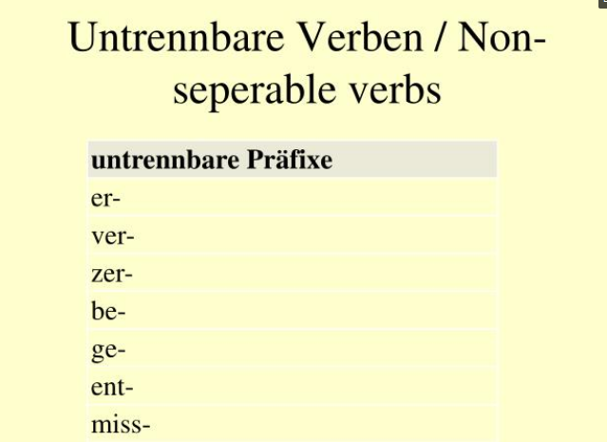
You should never separate these prefixes

Slide 8
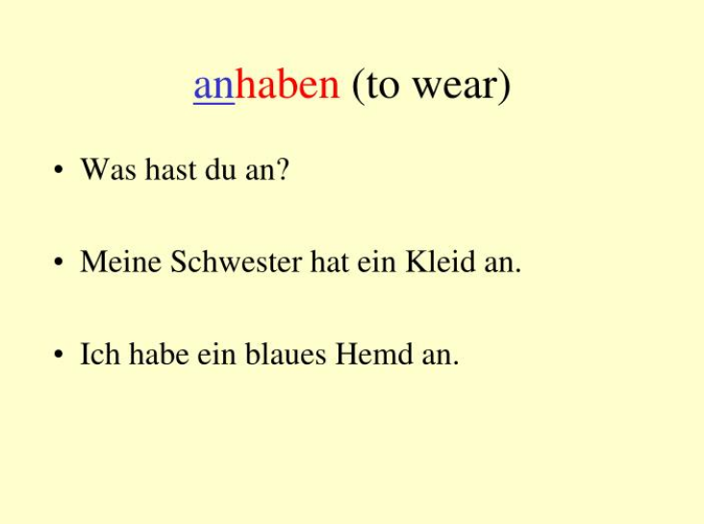
Some more examples of separable prefixes

Slide 9
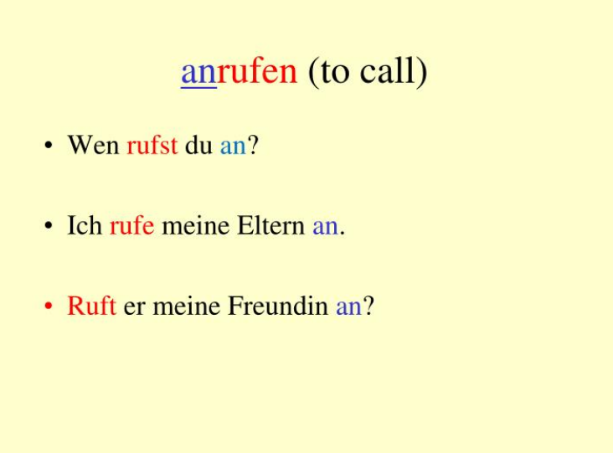
Examples of separable prefixes

Slide 10
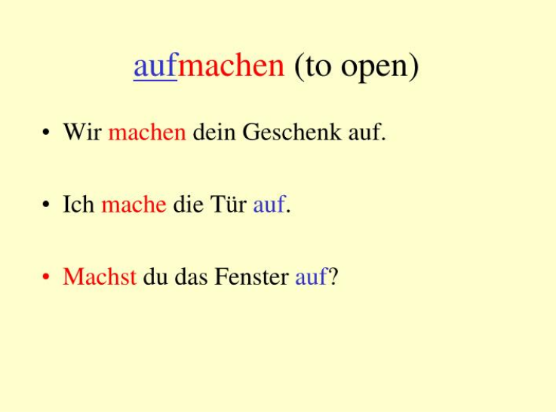
Examples of separable prefixes

Slide 11
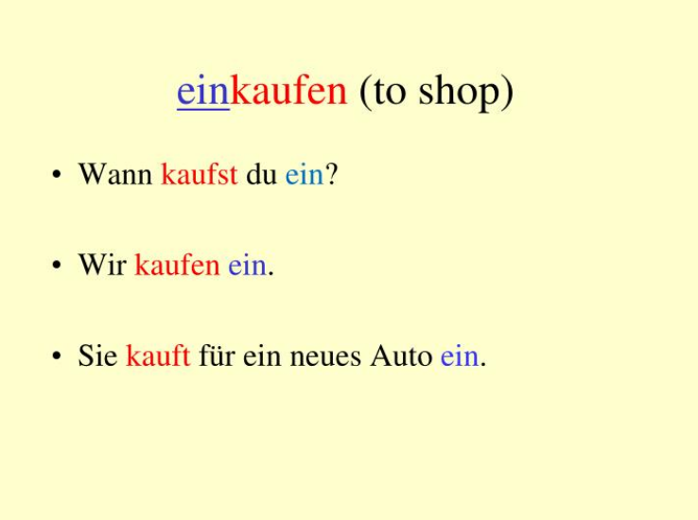
Examples of separable prefixes

Slide 12
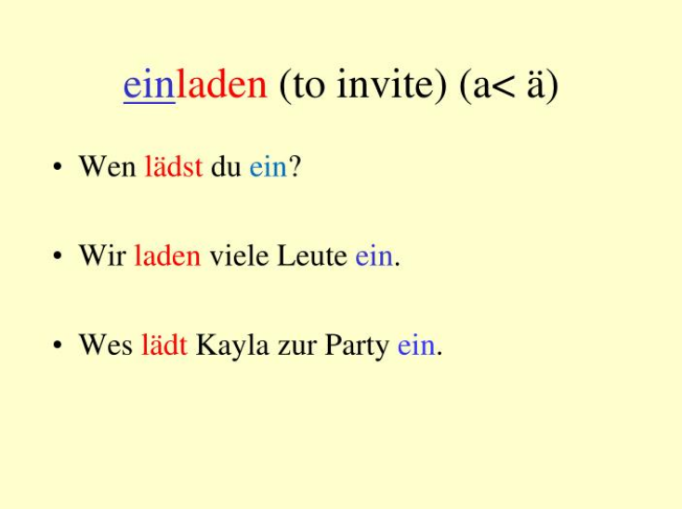
Examples of separable prefixes

Slide 13
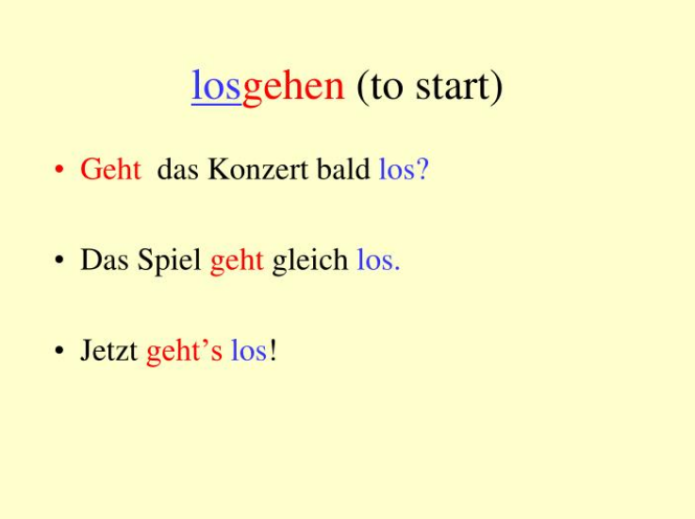
Examples of separable prefixes

Slide 14
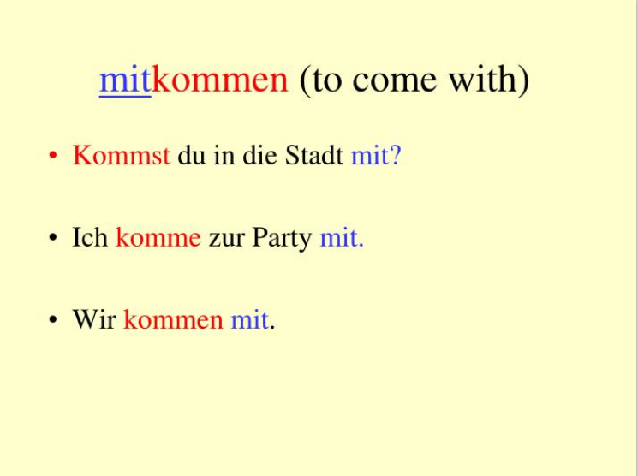
Examples of separable prefixes

Slide 15
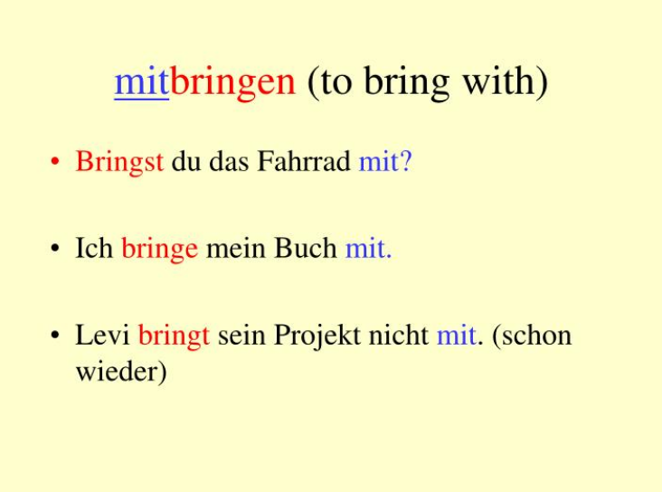
Examples of separable prefixes

Slide 16
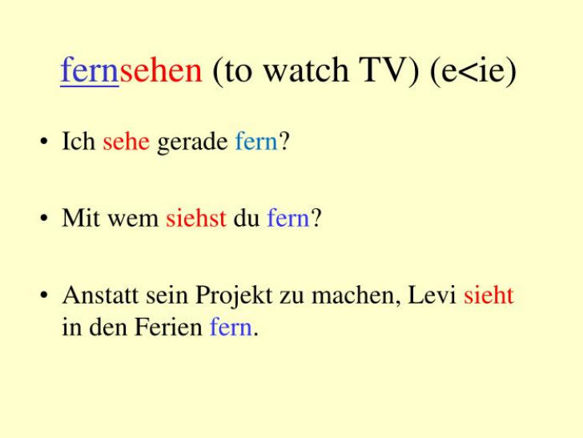
Examples of separable prefixes

Slide 17
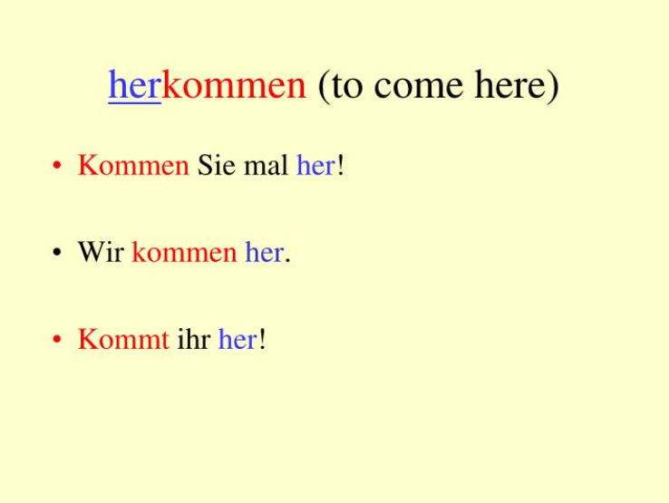
Examples of separable prefixes

Slide 18
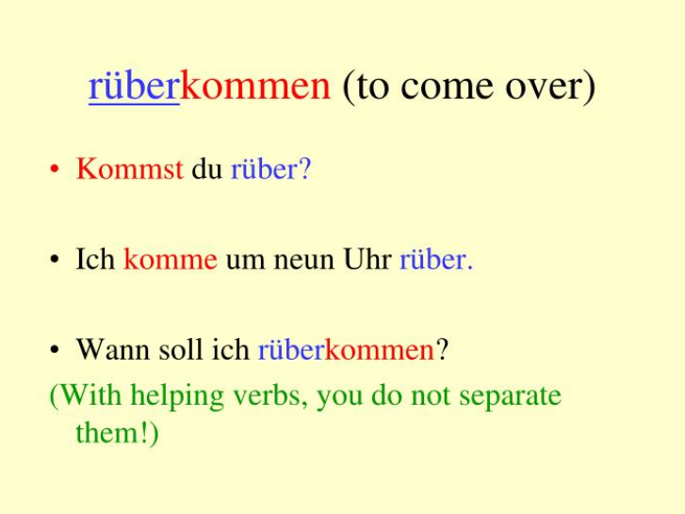
Examples of separable prefixes

Slide 19
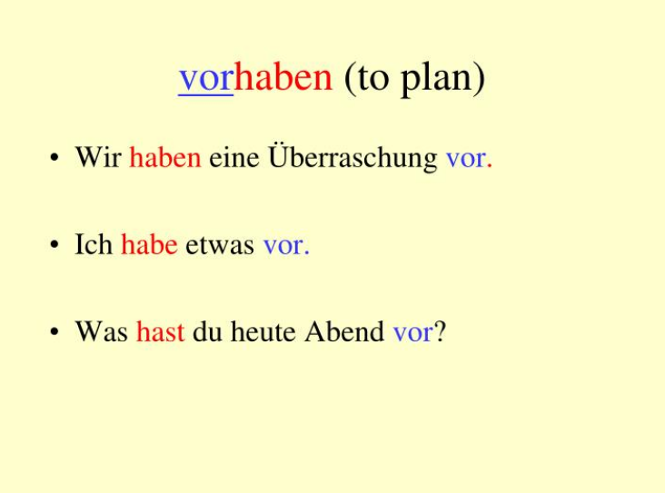
Examples of separable prefixes

Slide 20
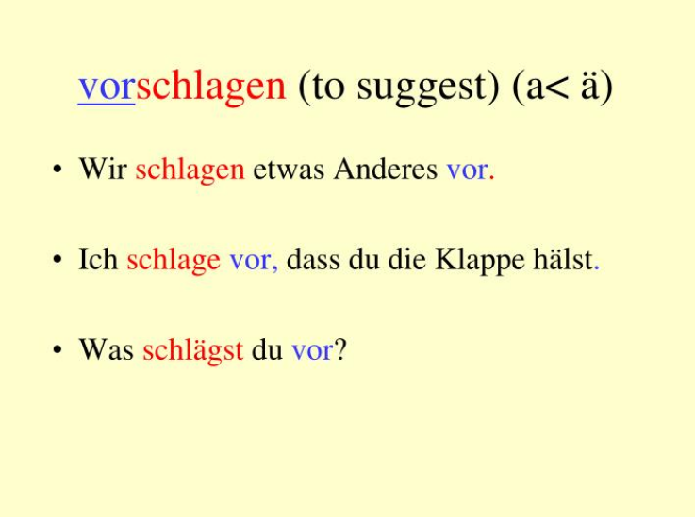
Examples of separable prefixes

Slide 21

Used with a modal verb we have to use the infinitive of the separable verb:
Ich muss immer abwaschen!

